Slide 1
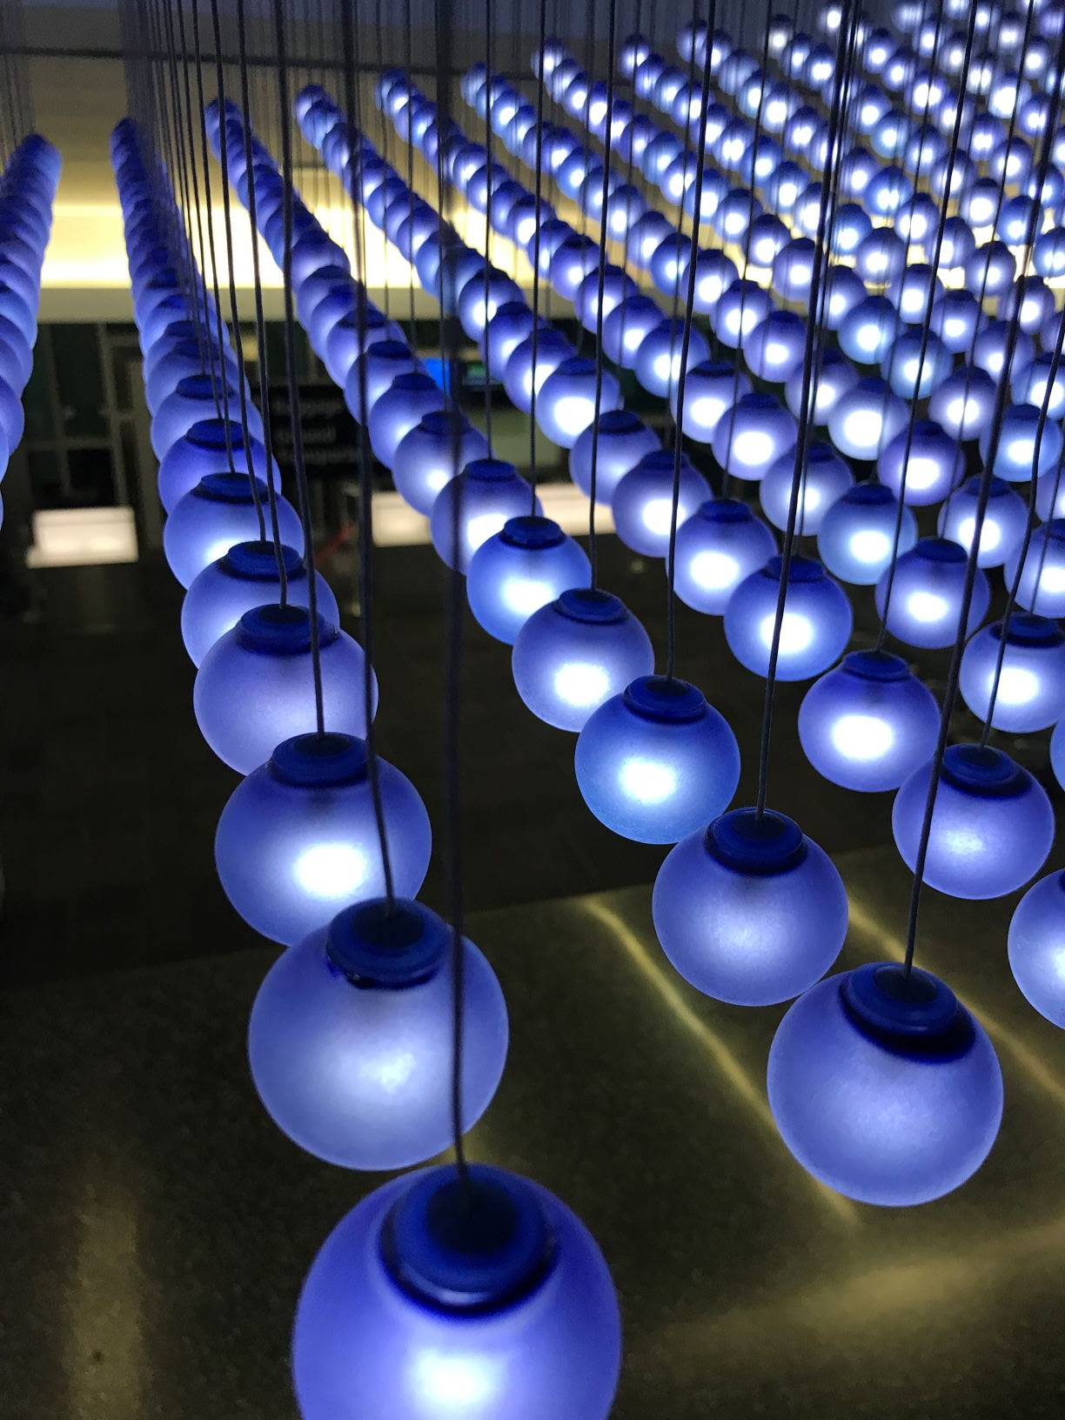
Before treatment
During treatment
After treatment

